Slide 1

E-Corp Discussion and Demo
HashiCorp
June 2019
E-Corp
Notes:
we got a lot to cover so let’s get going…

Slide 2


About Me
Mike Augustine
(Devops/Enterprise/“functioning” Architect/Engineer)
Sr. Enterprise Architect
Notes:
That’s me in the Hashi way

Slide 3

Today’s Agenda
We will cover:
Set the understanding of current state
Address concerns of the “business value”
Dive into the technical demo
Wrap up and Q&A
Notes:
diverse audience, some targeted messaging, some combined
ground rules – can be interactive, we’ll check in with each other, Q&A at end also

Slide 4







Current State and Concerns
E-Corp is going cloud and HashiCorp is likely a part of that
Is it easy enough to use and extend and yet powerful enough to handle our complexities
Need a deeper dive into the tech for our engineers to make sure they are on board
Is it really enterprise level?
Is it an integrated suite or a collection of disparate tools?
Any others?
Will it get me all DevOps'd?
Notes:
State – bullet 1: We are glad to be at this critical juncture with E-Corp
Business Concerns Left side
Technical concerns Right side

Slide 5




HashiCorp Product Evolution
Ideas to
Open Source to Funded Corporation
Open Source and Community Support
Expansion to Enterprise Level Product & Enterprise Customers
Awesome teams built on and from the original vision
Notes:
Is it Enterprise Level
My experience with community based enterprise software
Founders staying involved in their areas of expertise
Expansion of customer base and products is evidence alone

Slide 6
Several independent, multi-functional tools - Really integrated?
Compatible?
Notes:
Is it an integrated suite ?
When I first worked with the tools, the story wasn’t clear
Even each product a bit schizophrenic
[ Jump to layer slides ]
Marketing hasn’t invented story, they have translated the original vision
Will see more in the demo

Slide 7
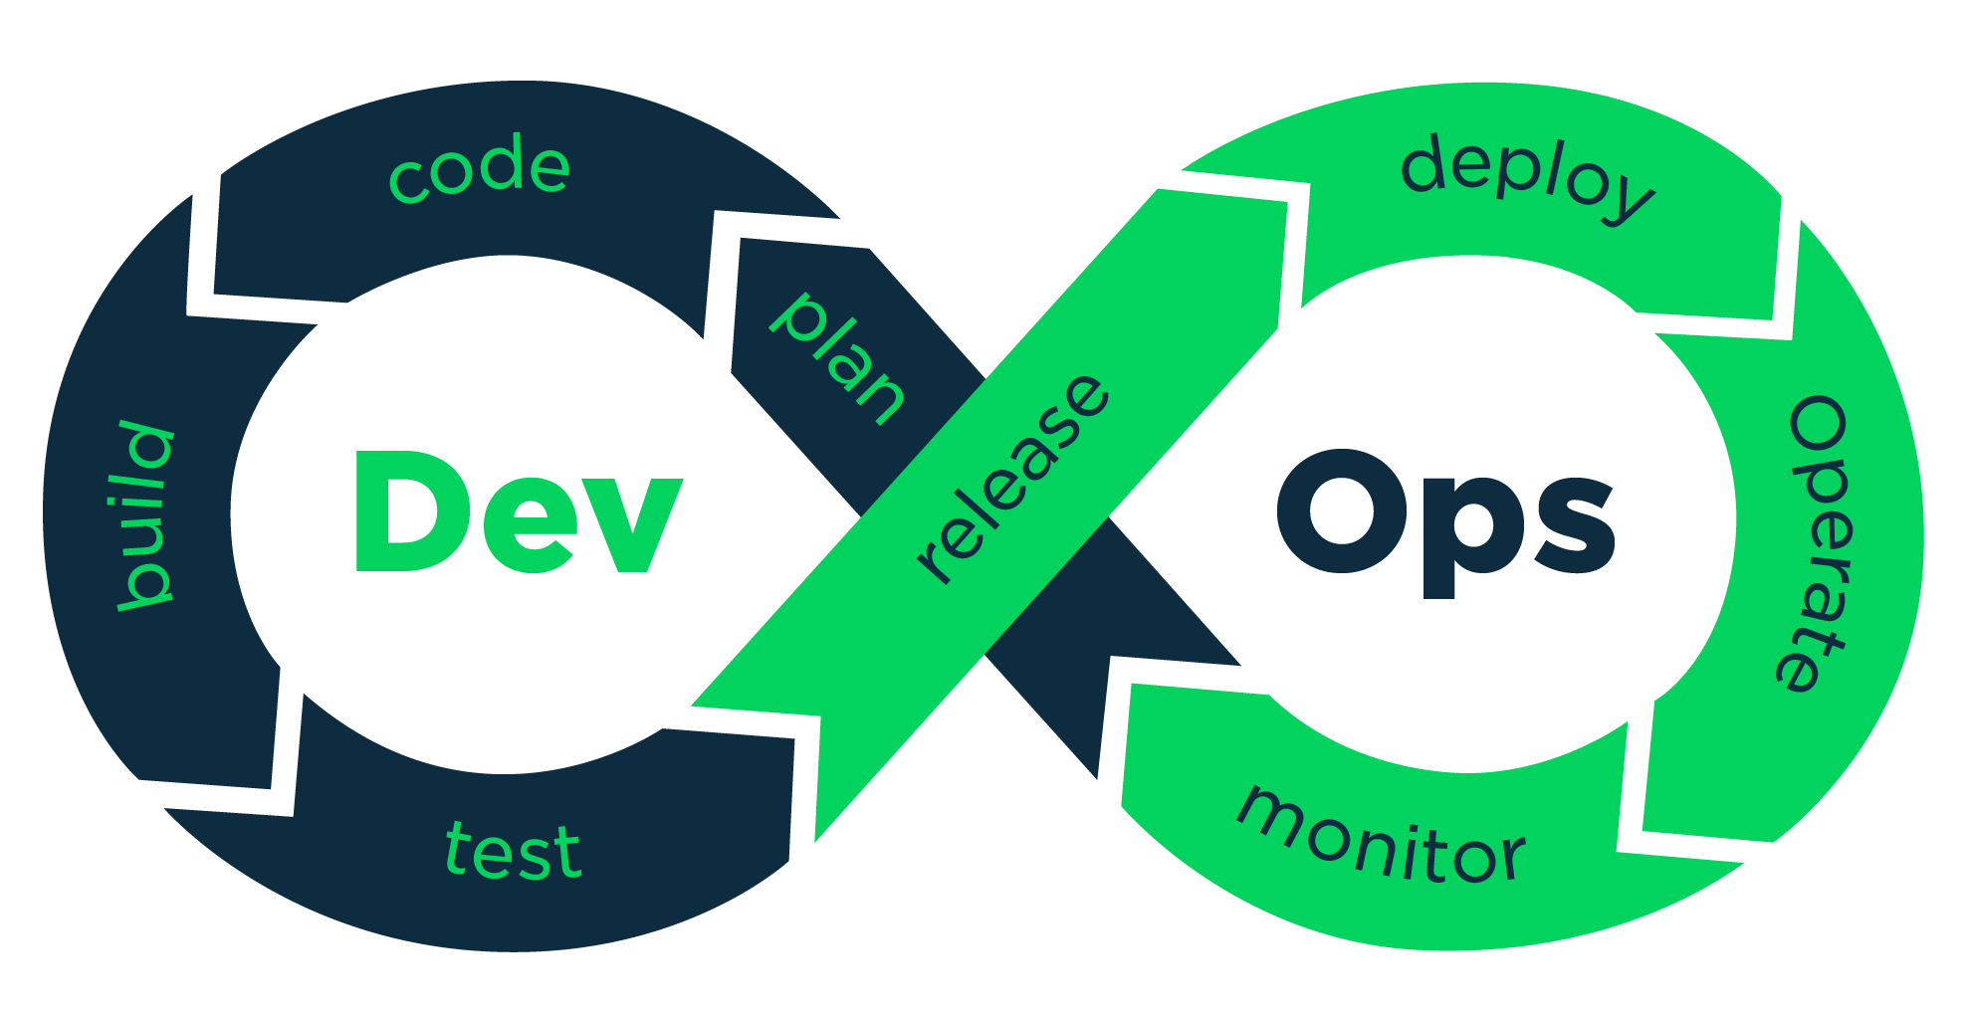
Will it get me all DevOps'd?
Sure. What is the real definition of DevOps / DevSecOps?
Notes:
After bullet go to Hashi def

Slide 8
https://www.hashicorp.com/devops-defined
The definition of DevOps varies from business to business, but the zeitgeist of DevOps is about minimizing the challenges of shipping, rapidly iterating, and securing software applications. HashiCorp defines DevOps as an organizational process tied to the needs of modern applications, with a focus on empowering individuals to improve agility.
The challenge for operations teams moving to cloud is to enable automation through infrastructure as code while embracing the inevitable heterogeneity of different cloud providers.
DevOps primarily involves the people responsible for delivering applications, including developers, operators, and security professionals. These three interdependent roles need tightly coupled tools to coordinate their contributions to application delivery.
Notes:
.

Slide 9
Will it get me all DevOps'd?
So DevOps is a smart collection of tools
Is a functional collection of people/roles
Is a cultural evolution
Does cover a small to large collection of functional areas/flows/processes
The HashiCorp Tools will help you get there, but not by themselves and not without the non-tool aspects.
Notes:
.

Slide 10

Technical Demo!
Workstation - Set up development environment
Build Images - Prepare for provisioning infrastructure
Build infrastructure – provision
Configure and review
Notes:
First any questions so far?

Slide 11













Source Code Repository
Supporting
Tools
OS ISO
Provisioning / Configuration
Artifact/ Module Repositories
OS Image
Image Creation
Network & Services
VM Creation
OS/App Image
Boxes
Workstation
(testing, small scale infrastructure)
Notes:
Meant to be simplistic
Walk briefly – emphasize key tenants and choices
Config tools demonstrate compatibility and reusability
Describe what is used in demo

Slide 12








AWS Cloud
Availability Zone 1
Availability Zone 2
Availability Zone 2
VPC
Public subnet
Vault
NAT gateway
Bastion host
Elastic Load Balancing (ELB)
Consul
Nomad
Private subnet
Private subnet
Private subnet
Auto Scaling group
Consul, Vault, Nomad
Consul, Vault, Nomad
Consul, Vault, Nomad
Notes:
Meant to be simplistic

Slide 13

Contact Me
Mike Augustine
mike.augustine@hashicorp.com
@MAugustine825
Q & A
Notes:
Questions? Contact me if you have questions.
Email address won’t be activated for a few weeks ☺

